Slide 1
Modeling as design technique
A model is an abstraction for visualization.
Specify the structure, behavior and template before actual building.
For complex systems, developer must abstract different views of system by building models.
Verify that the model satisfy requirements.
Gradually add details to transform model into implementation.

Slide 2
Modeling
Example: Airplane scale model for wind turbulence, pencil sketches for oil paintings, blueprint of machine parts etc.
Purpose of modeling:
Reviewing a physical entity before building.
Communication with customer.
Visualization: Storyboards of movies and advertisements, sketches for artists.
Reduction of complexity: House design does not include number of bricks, cements etc.

Slide 3
Types of Models
Class model: Represents static and structural aspects of system.
State model: Represent temporal and behavioral aspects of system.
Interaction model: Represent interaction collaboration and interaction of individual objects.
These designs are not completely independent.
A good design must isolate between them.

Slide 4
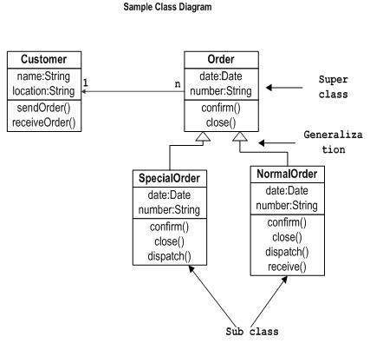
Class Diagram

Slide 5
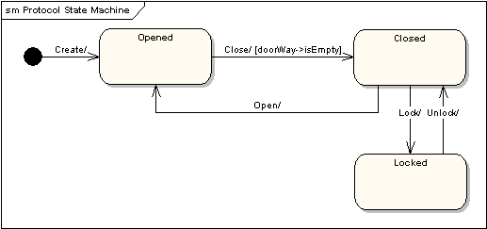
State Diagram

Slide 6
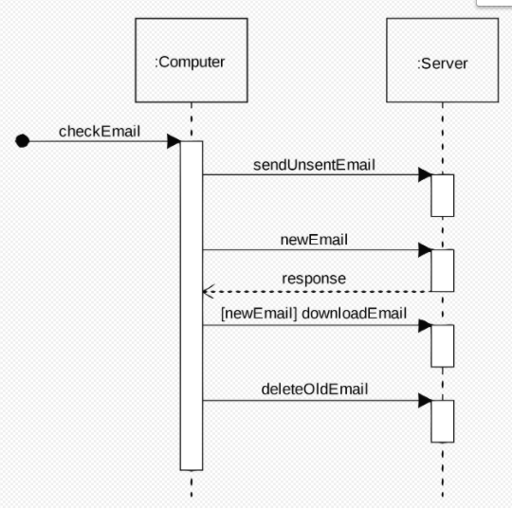
Interaction Diagram

Slide 7
UML (Unified Modeling Language)
Focus on conceptual and physical representation of system.
Standard language for software blueprint.
Requirement of multiple models?
UML tells how to create well formed model but do not tell what model you should create (Role of software development process).

Slide 8
UML Properties
Visualization: For example class hierarchy (easy to visualize than direct interpretation from code).
Specification: Building models that are precise, unambiguous and complete.
Construction: UML models can be directly connected to various programming languages.
Used for forward engineering.
Documentation
Control, measure and communicate about system.

Slide 9
Applications of UML
Enterprise information system.
Banking services.
Telecommunication.
Transportation.
Defense/aerospace.
Scientific and distributed web services.
UML can also model non-software systems such as workflow in legal systems.

Slide 10
Conceptual model of UML
Understand basic building blocks of UML, rules for integrating building blocks and some common mechanisms applied throughout UML.
Building blocks of UML
Things (Entity)
Relationship (relate things)
Diagrams (collection of things based on interest)

Slide 11
Things in UML
Structural Things
Static nouns of UML models.
Elements that are either physical or conceptual.
For example:
Class
Interface
Collaboration
Active classes
Use cases
Components (replaceable part of system that provide realization to interfaces).
Nodes (Servers: A collection of components)

Slide 12
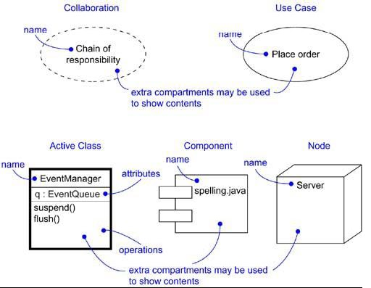
Structural Things

Slide 13
Behavioral Things
Dynamic parts of UML.
Represent behavior over time and space.
Interactions: to provide interaction between a set of objects (Messages).
State machine: Define sequence of states for an object during its lifetime in response to events.

Slide 14
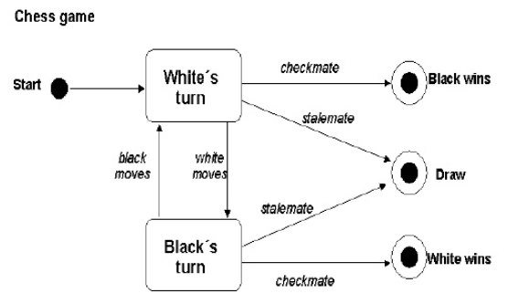
Behavioral Things

Slide 15
Grouping Things
Packages are used to grouping things.
General purpose mechanism for organizing elements into groups.
Structural and behavioral things placed in a package.

Slide 16
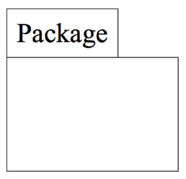
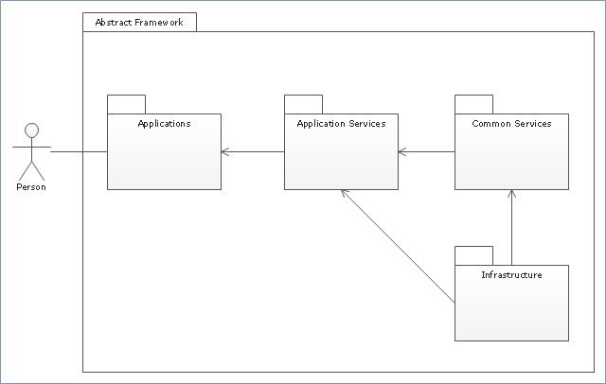
Packages

Slide 17
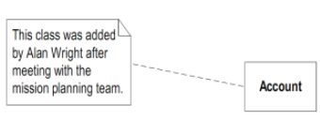
Annotational Things
Explanatory parts of UML called note.
Comments applied to describe and remark about any element or collection of elements in the model.
A rectangle with dog-eared corner.

Slide 18
Relationships in UML
Four types of relationship:
Dependency
Association
Generalization
Realization

Slide 19
Dependency
Semantic relationship between two entities.
Change to one thing affect semantic of other thing.
In UML, dependency denoted by dashed line, possibly directed and may have a label.
------------------------------>

Slide 20
Association
Structural relationship describing a set of links.
Links define connection among objects.
Aggregation is a special type of association between a whole and its parts.
Association is denoted by solid line, possibly directed and may include a label.
___________________

Slide 21
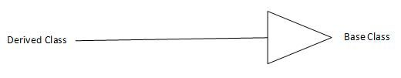
Generalization
Objects of specialized elements (Child) are substitutable for objects of generalized elements (parent).
Child shares structure and behavior of parent.
It is denoted by a solid line with hollow arrowhead, pointing to parent.

Slide 22
Realization
Relationship between classifiers, wherein one classifier specifies a contract that another classifier guarantees to carry out.
Occurs between interfaces and classes or components that realize them.
Or between use cases and collaboration that realize them.
Denoted by dashed line with hollow arrowhead.

Slide 23
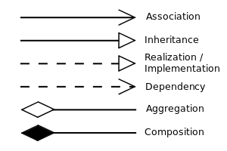
Relationship notations in UML

Slide 24
Diagrams in UML
Graphical representation of set of elements in a graph with vertices (things) and edges (relationship).
Visualize a system from different perspectives.
The same element may appear in different diagrams.
UML contain nine types of diagrams.

Slide 25
Diagrams in UML
Class Diagram
Object Diagram
Use Case Diagram
State-chart Diagram
Sequence Diagram
Component Diagram
Activity Diagram
Collaboration Diagram
Deployment Diagram

Slide 26
1. Class Diagram
A class diagram shows a set of classes, interfaces, and collaborations and their relationships.
Most common diagram found in modeling object-oriented systems.
Address the static design view of a system.

Slide 27
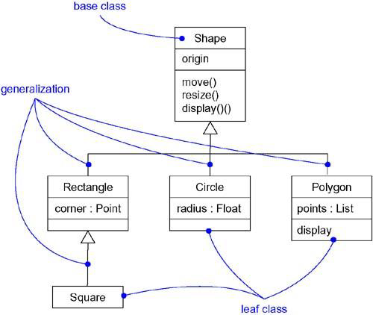

Slide 28
2. Object Diagram
Shows a set of objects and their relationships.
Represent static snapshots of instances of the things found in class diagrams.
Address the static design view or static process view of a system as do class diagrams, but from the perspective of real or prototypical cases.

Slide 29
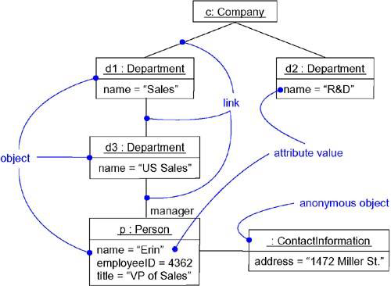

Slide 30
3. Use Case Diagram
Shows a set of use cases and actors (a special kind of class) and their relationships.
Address the static use case view of a system.
Especially important in organizing and modeling the behaviors of a system.

Slide 31
Interaction Diagrams
Both sequence diagrams and collaboration diagrams are kinds of interaction diagrams.
Arc shows an interaction, consisting of a set of objects and their relationships, including the messages that may be dispatched among them.
Interaction diagrams address the dynamic view of a system.

Slide 32
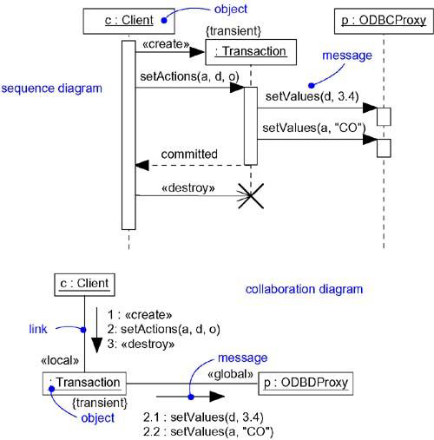
4. Sequence Diagram
5. Collaboration Diagram

Slide 33
6. Statechart Diagram
Shows a state machine, consisting of states, transitions, and events.
Address the dynamic view of a system.
Model the behavior of an interface, class, or collaboration
Emphasize the event-ordered behavior of an object.

Slide 35
7. Activity Diagram
Special kind of a state-chart diagram that shows the flow from activity to activity within a system.
Activity diagrams address the dynamic view of a system.
Emphasize the flow of control among objects.

Slide 37
8. Component Diagram
Shows the organizations and dependencies among a set of components.
Address the static implementation view of a system.
They are related to class diagrams in that a component typically maps to one or more classes, interfaces, or collaborations.

Slide 38
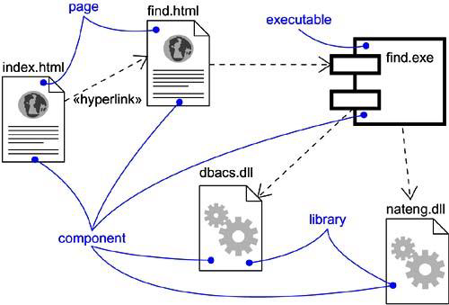

Slide 39
9. Deployment Diagram
Shows the configuration of run-time processing nodes and the components that live on them.
Address the static deployment view of an architecture.
They are related to component diagrams in that a node typically encloses one or more components.

Slide 40
Modeling system’s architecture
Visualizing, specifying, constructing, and documenting demands various perspectives to view a system.
Different stakeholders- end users, analysts, developers, system integrator, testers, writers, project manager etc.
Architecture of software intensive system described using five interlocking views: use case, design, implementation, process, and deployment.

Slide 41
Modeling system’s architecture
Use case describe behavior of a system seen by end-users, analysts and testers.
Define static view of system .
Dynamic view are captured in interaction, state- chart and activity diagram.
Design view contains classes, interfaces, collaborations to form vocabulary of system and its solutions.
Supports functional requirements of the system.
Involve class diagram and object diagram.

Slide 42
Modeling system’s architecture
Process view encompasses threads and processes that form system’s concurrency and synchronization mechanisms.
Address performance, scalability, and throughput of system.
Focus on active classes to represent threads and processes.

Slide 43
Modeling system’s architecture
Implementation view define components and files which are used to release physical system.
Address configurational management of system’s releases made up of independent components and files.
Static aspect of this view captured in component diagram and dynamic view captured in interaction diagram.

Slide 44
Modeling system’s architecture
Deployment view encompasses nodes that form system’s hardware topology on which system executes.
Address distribution, delivery and installation of parts that make physical system.
Static view captured in deployment diagram.

